Slide 1
Keep your work warm
(and safe) using Git
Notes:
[Mandatory Slide] This would be the introduction slide of the topic that you are covering in this subsection.
When this slide plays, you could talk about the main aim that we’d be covering in this video.

Slide 2
In this Video, we are going to take a look at…
What are Version Control Systems?
What is Git?
Installing Git
Create a sample Git repository
Notes:
[Mandatory Slide]
Before the start of the video, we’d like to highlight what are important topics or pointers that we’d be covering in this video. This slide would immediately follow the intro/name slide. This would just be say 2-3 points for the viewers to know what they are getting into.

Slide 3

What are Version Control Systems?
Software that help developers manage changes to code over time
They track every set of modifications (version) made by each contributor to the codebase, allowing to:
revert mistakes
check mods history and compare mods
prevent conflicts on concurrent mods
They are also a way to backup codebases
Notes:
This slide can also be used to cover topics that can be represented by an image/graph etc. Information which is half image/half information type. Like shown in the example above.

Slide 4


What is Git? (1/2)
Git is an open source distributed Version Control System
In Git, the full version history of the codebase is kept both in a remote repository (upstream) and in local working copies (clones)
Git is widely used by open source projects and enables a rich ecosystem of services and collaboration tools (eg. GitHub)
Notes:
This slide can also be used to cover topics that can be represented by an image/graph etc. Information which is half image/half information type. Like shown in the example above.

Slide 5
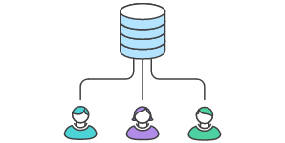
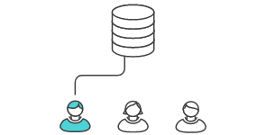
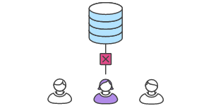
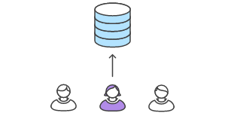

What is Git? (2/2)
A typical Git workflow
1. Upstream is initialized and everyone clones it
2. Bob commits his work to the clone. When he’s done, he pushes to the upstream
3. Alice tries to push her work but incurs in merge conflicts.
4. Alice pulls Bob’s mods and locally fixes the conflicts. She’s then able to push
Notes:
This slide can also be used to cover topics that can be represented by an image/graph etc. Information which is half image/half information type. Like shown in the example above.

Slide 6
Installing Git
Steps:
Visit https://git-scm.com/downloads
Select your platform and follow the instructions
When installation is completed you can invoke Git from the command line
On Windows, a “Git Bash” command line will be installed along with Git
Notes:
[Mandatory Slide]
Before the start of the video, we’d like to highlight what are important topics or pointers that we’d be covering in this video. This slide would immediately follow the intro/name slide. This would just be say 2-3 points for the viewers to know what they are getting into.

Slide 7
Create a sample Git repository
Notes:
Something that needs to grab the viewers attention!!

Slide 8
Summary
Insights on VCSs’ features
What is Git and how to work with it
Create and use a sample Git repository
Notes:
This slide, like mentioned is to summarize the various videos we have seen in this section. This gives the viewers a sense of achievement that they have covered exactly what they were looking for.

Slide 9
Setup of a sample Python project
Next Video
Notes:
[Mandatory Slide]
Here the name of the next video needs to be mentioned. The narration as you guessed it would be just letting the viewer know exactly where we are at and what we’d be taking over next! ☺

